Slide 1
MULTISTAGE ATTACK ANALYSIS USING FACTORGRAPHS
Spring 2018
<Group 9> : <pthiagu2>

Slide 2
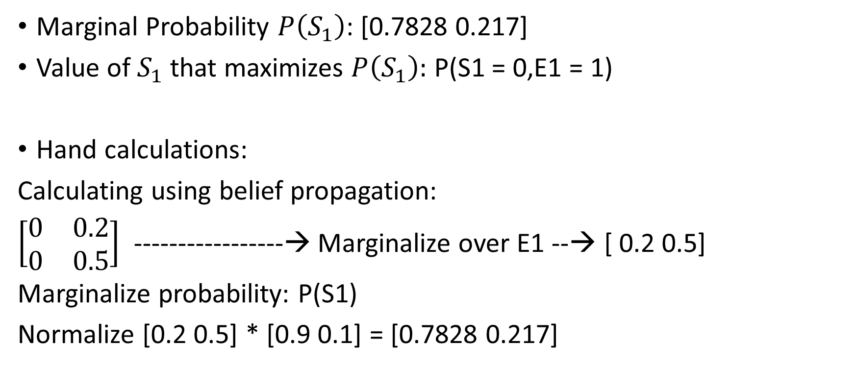
Task 2 – Simple Factor Graph
Marginal Probability $P\left(S_{1}\right)$: [0.7828 0.217]
Value of $S_{1}$ that maximizes $P\left(S_{1}\right):$ P(S1 = 0,E1 = 1)
Hand calculations:
Calculating using belief propagation:
$\left[\begin{matrix}0 & 0.2 \\ 0 & 0.5\end{matrix}\right]$ -----------------→ Marginalize over E1 --→ [ 0.2 0.5]
Marginalize probability: P(S1)
Normalize [0.2 0.5] * [0.9 0.1] = [0.7828 0.217]

Slide 3
Task 2 – Simple Factor Graph
By brute force,P(S1 = 0,E1 = 1) = 0.726
P(S1 = 0,E1 = 0) = 0
P(S1 = 1,E1 =0) = 0
P(S1 =1,E1 = 1) = 0.2016
Maximum probability = P(S1 = 0,E1 = 1) = 0.726. So the state P(S1 = 0,E1 = 1) maximizes the probability.

Slide 4
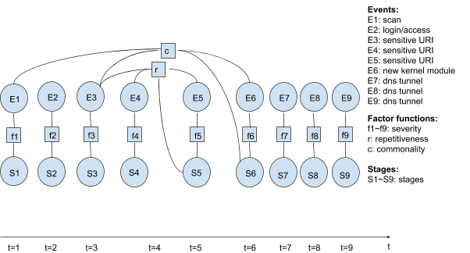
Task 3 – Factor Graph Inference
Image of factor graph defined in your code:

Slide 5
Task 3 – Factor Graph Inference
Hidden State | Time | Attack Stage | Recommended Action | Selected Stage(By Code)
S1 | 1 | Discovery/Benign | No-op | Discovery
S2 | 2 | Benign | No-op | Benign
S3 | 3 | Benign/Privilege Escalation | No-op | Benign
S4 | 4 | Benign/Privilege Escalation | No-op | Benign
S5 | 5 | Benign/Privilege Escalation | Monitor | Privilege Escalation
S6 | 6 | Persistence,/Benign | Monitor | Persistence
S7 | 7 | Benign/ Exfiltration | Stop | Exfiltration
S8 | 8 | Benign/ Exfiltration | Stop | Exfiltration
S9 | 9 | Benign/ Exfiltration | Stop | Exfiltration

Slide 6
Task 3 – Factor Graph Inference
How did you pick the recommended action for each step?
The recommended action for each time step has been picked by first calculating the marginal probabilities and then picking up the attack stage which has the maximum probability. The recommended action is selected by taking a maximum on the prior probabilities given for that particular stage attack.
At what time step should you stop the attack?
There is equal probability for benign and privilege escalation for t = 3 and t = 4 even though the code selects benign as the attack stage. It is best to stop the attack at t =5 as the attacker gets privilege escalation. The worst case scenario would be to stop the attack at t = 6.According to the code, the attack should be stopped at t = 7.

Slide 7
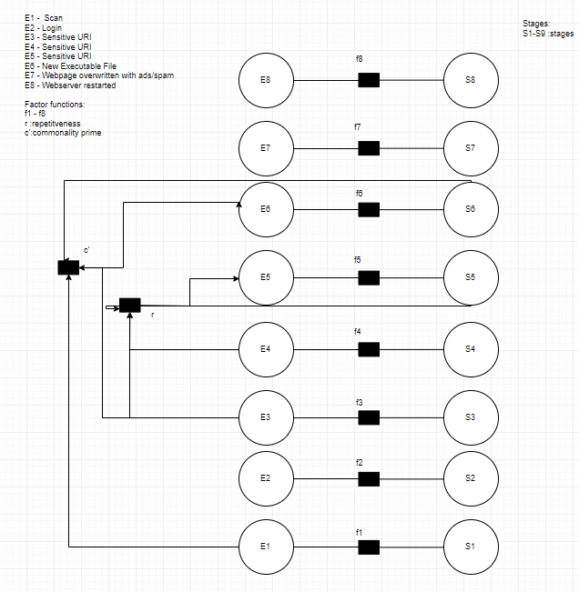
Task 4
Image of factor graph

Slide 8
Task 4
Highlight elements common to the factor graph in Task 3
They have common events like scan, login and sensitive URI. They have similar repetitive event sequence. The attack stages for new kernel module and new executable file are the same. Though the attack stages are different, they both have a commonality sequence.
To add a new event to your factor graph, what additional information is required?
We need information on attack states, significance and past attack probabilities for that particular event. We also need to know the attack states in case of repetitiveness. We also need to know the action probabilities for the attack stages present for that particular event.

